Slide 1

Human Activity Recognition 2021WS-M1-Introduction to Machine Learning
Hachmann Isabela
Ivanov Kirill
Kapaj Arjon
Leon Martin
Safavinejad Arash
https://www.yellowtrace.com.au/human-motion-sculpture/

Slide 2
WHAT you will see here
What is Human Activity Recognition?
Data generation
Data Exploration
Chosen model and why?
Results and interpretation

Slide 3
WHAT IS HAR?
HUMAN ACTIVITY RECOGNITION (HAR)
The procedure of recording, processing and analyzing human movements for the purpose of identifying specific movements of a person based on sensor data.

Slide 4
LET’S GENERATE data
4 MOVEMENTS
the duration of each movement
repetition of each movement

Slide 5
SAMBA
WALKING
https://www.hindustantimes.com/fitness/walking-regularly-for-40-minutes-makes-your-heart-stronger-here-s-what-science-says/story-0Xi8lSlSBma8uhkxFwbsYI.html
chosen movements
SALSA
WALKING DOWNSTAIRS
https://www.everydayhealth.com/specialists/healthy-living/benefits-of-going-down-stairs/

Slide 6
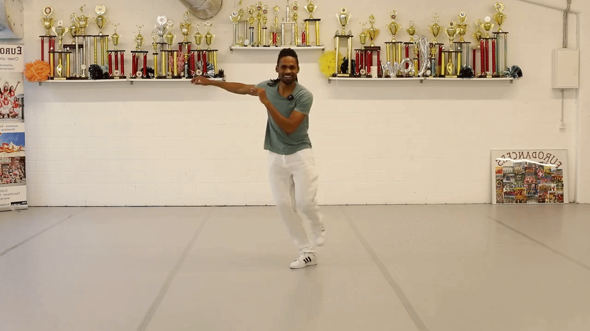
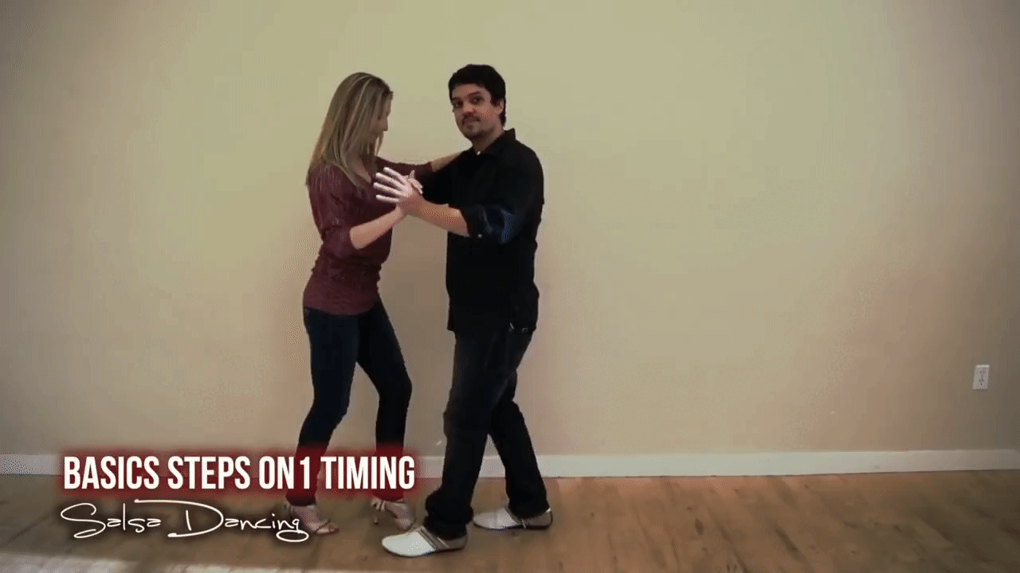
Samba
Salsa

Slide 7
1 minute/movement 10 times/movement
lET’S DANCE

Slide 8
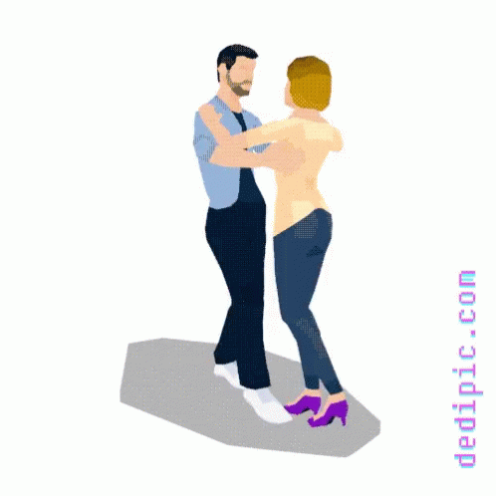
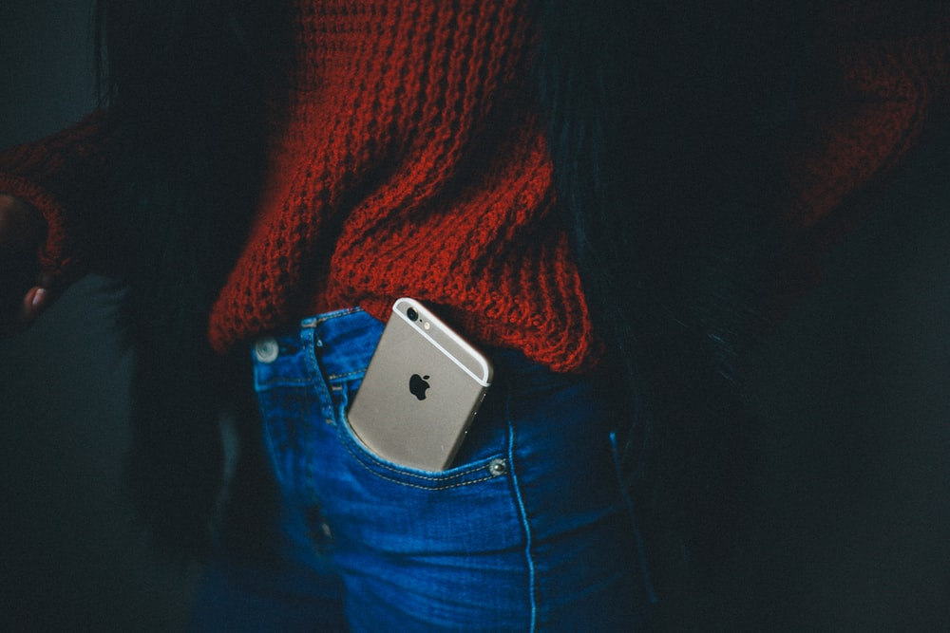
how we recorded the data
+
+
10 times/movement during 1 min
collect data
Label 4 movements
200 records
PROCESS data
Notes:
Each member of the group.

Slide 9
How could we work together?
storing
data
coding
together
Notes:
One big challenge

Slide 10
dataset to start coding
g-Force Linear Accelerometer Gyroscope
time | gFx | gFy | gFz | ax | ay | az | wx | wy | wz
(9 variables x 7 measurements) = 64 variables
std | max | min | mean | mean_number_of_peaks | max_min | sum_abs | label

Slide 11
dataset to start coding
g-Force Linear Accelerometer Gyroscope
time | gFx | gFy | gFz | ax | ay | az | wx | wy | wz
(9 variables x 7 measurements) = 64 variables
std | max | min | mean | mean_number_of_peaks | max_min | sum_abs | label

Slide 12
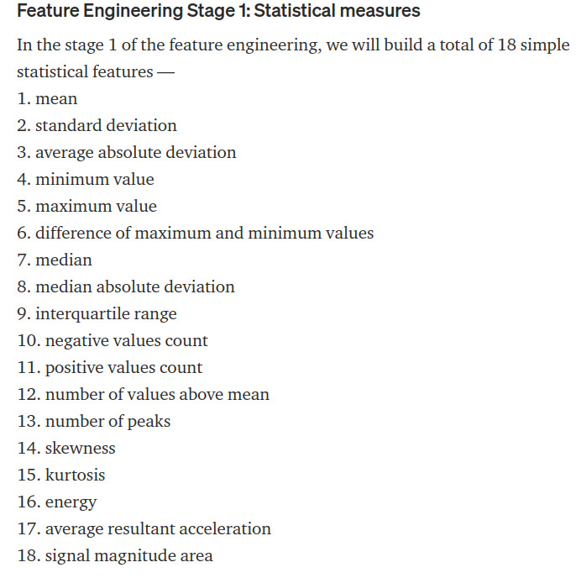
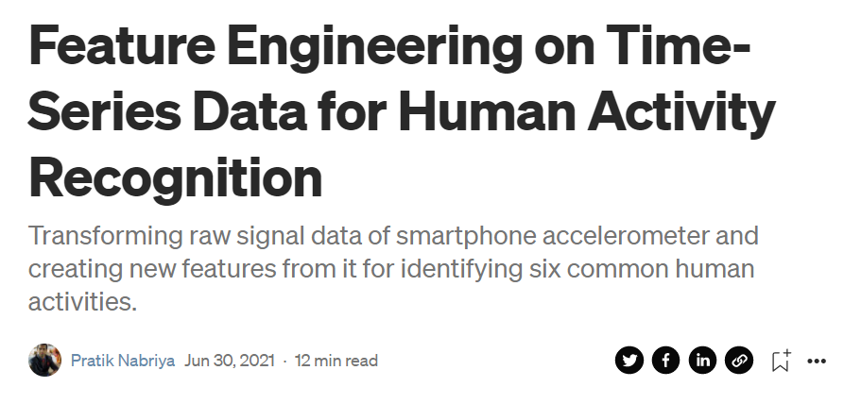
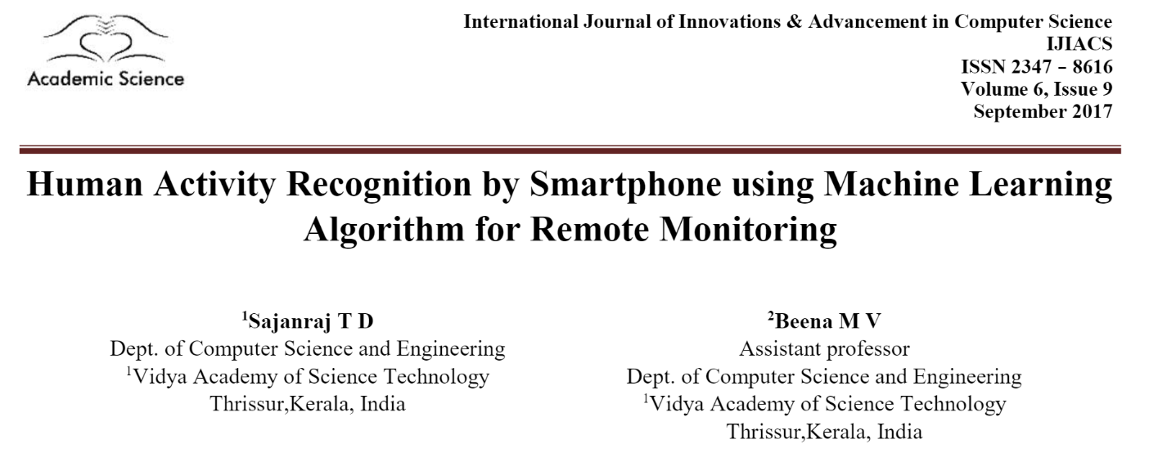
Why this variables?
https://towardsdatascience.com/feature-engineering-on-time-series-data-transforming-signal-data-of-a-smartphone-accelerometer-for-72cbe34b8a60

Slide 13
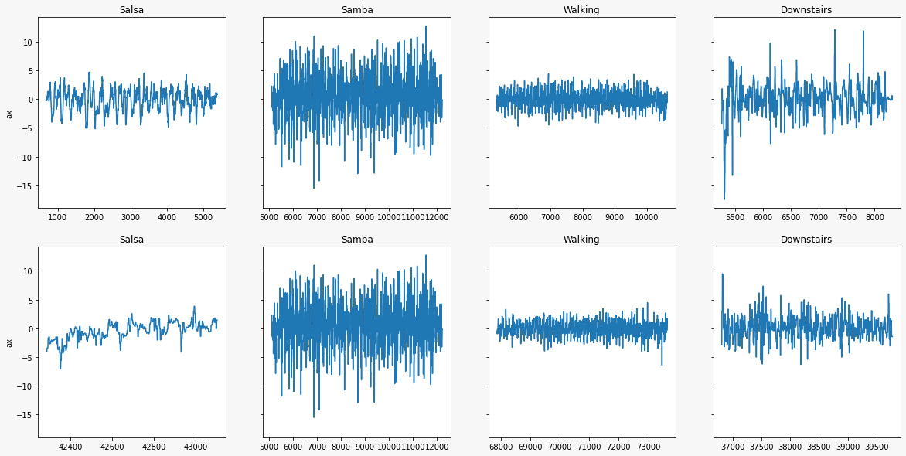
data exploration Before Feature creation
1st Record
15th Record

Slide 14
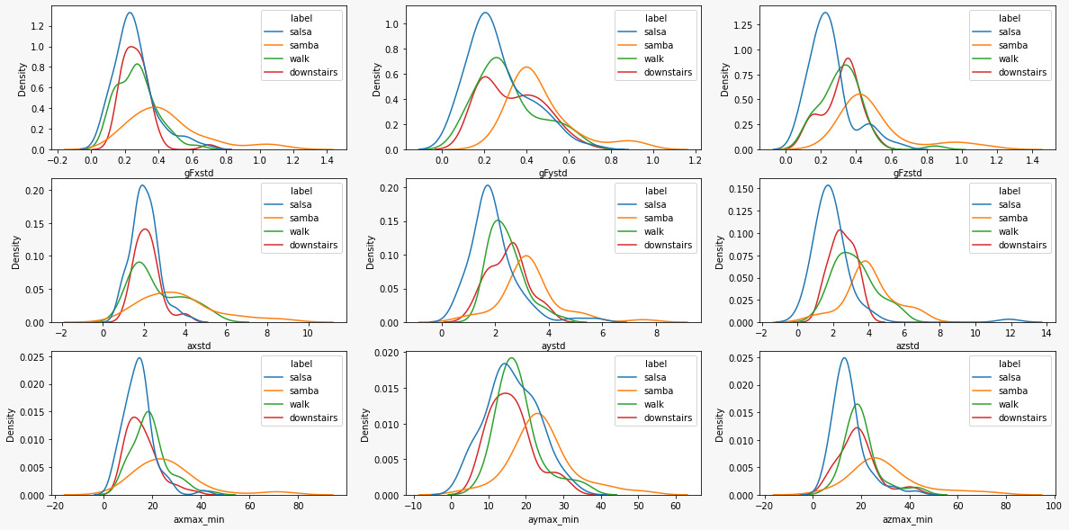
data exploration After Feature Creation

Slide 15
PreProcessing
…

Slide 16
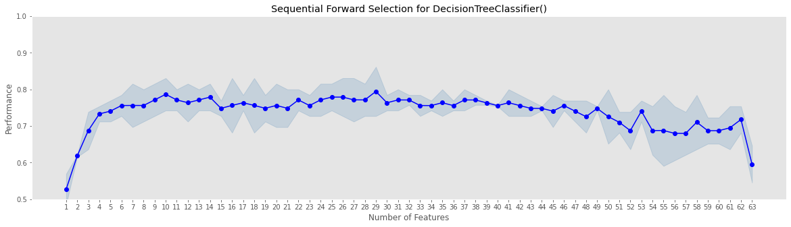
Feature engineering Forward Wrapper Method

Slide 17
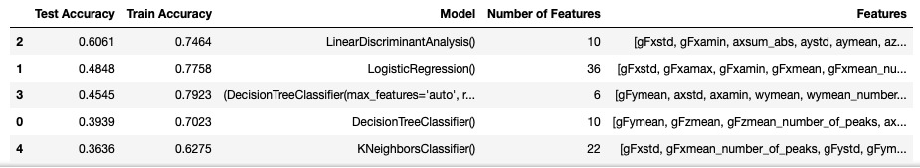
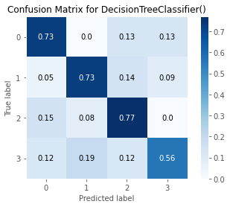
Model Selection

Slide 18
Model Selection
With a selected model we should do an hyperparameter tunning and reach a higer acuracy

Slide 19
interpretation
Which movement the model predicted best
How the model differentiated the two dance styles
What could still be improved in the model

Slide 20
improvement opportunities
More Data
More control on the recording of movements
More types of movements
Experienced dancers (not just basic steps)

Slide 21
Estimation of the amount of Data
… a plot that show the accuracy vs the number of records

Slide 22
THANK YOU!

